Slide 1

TITLE
Under the Guidance of xxxxxx.
Team members:
Xxxxxx xxxxx
Xxxxxx xxxxx

Slide 2
Introduction
Large-scale public events such as concerts, sports events, political rallies, and festivals require continuous monitoring to ensure public safety.
Traditional surveillance systems rely heavily on manual CCTV monitoring, making them reactive, time-consuming, and prone to human error.
Delayed identification of incidents such as fire, crowd surges, violence, and missing persons can lead to serious consequences.
Recent advancements in Artificial Intelligence (AI), Computer Vision (CV), and Vision-Language Models (VLMs) enable automated real-time surveillance and intelligent decision-making.
Vigilance is an AI-powered event monitoring platform that continuously analyzes live video streams, detects incidents, generates instant alerts, and coordinates emergency response.
The system integrates multiple AI modules such as object detection, facial recognition, crowd analysis, geo-intelligent navigation, and role-based dashboards into a unified platform.
The proposed solution aims to improve public safety, optimize resource allocation, reduce response time, and support proactive event management
"The best way to manage an emergency is to detect it before it becomes a disaster."

Slide 3
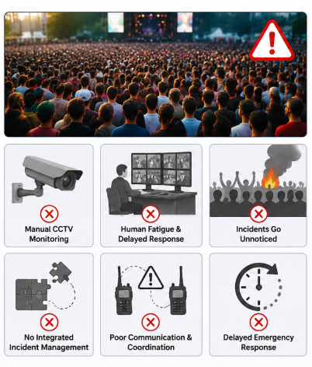
Problem Statement
Large-scale public events such as concerts, sports tournaments, festivals, and political rallies attract thousands of attendees, making crowd management and public safety highly challenging.
Traditional surveillance systems rely on manual CCTV monitoring, requiring security personnel to continuously observe multiple camera feeds.
Human monitoring is reactive, prone to fatigue, and unable to detect multiple incidents simultaneously, leading to delayed responses.
Critical incidents such as fire outbreaks, crowd surges, violence, medical emergencies, missing persons, and lost belongings often go unnoticed during the initial stages.
Existing systems lack real-time AI-based incident detection, automated alert generation, and intelligent resource coordination, resulting in fragmented emergency management.
Poor communication between organizers, volunteers, and emergency responders further delays incident resolution and increases operational risks.
Therefore, there is a need for an integrated AI-powered event monitoring platform that can automatically detect incidents, generate instant alerts, coordinate emergency teams, and ensure proactive safety management.

Slide 4
Goals
OBJECTIVES
Develop an AI-powered intelligent event monitoring system for large-scale public events.
Detect critical incidents such as fire, smoke, violence, crowd surges, and thermal anomalies in real time.
Monitor live CCTV/video streams using AI-powered Computer Vision.
Identify missing persons using facial recognition technology.
Locate lost items through AI-based visual similarity matching.
Generate instant alerts and notify the appropriate authorities automatically.
Provide role-based dashboards for administrators, volunteers, and attendees.
Enable GPS-based navigation and intelligent volunteer routing for faster emergency response.
Support Human-in-the-Loop (HITL) verification to validate AI-detected incidents before action.
Optimize resource allocation and improve overall event safety and operational efficiency.
Enable real-time surveillance, automatic incident detection, and proactive emergency response.
Improve public safety through computer vision, vision-language models, and geo-intelligent coordination.
Reduce response time by automating alert generation and incident management.
Provide a unified platform for administrators, volunteers, and attendees to ensure efficient events.
To build a smart, AI-driven platform that transforms traditional event surveillance into proactive, real-time incident management for safer and more efficient public events.

Slide 5
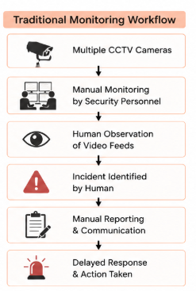
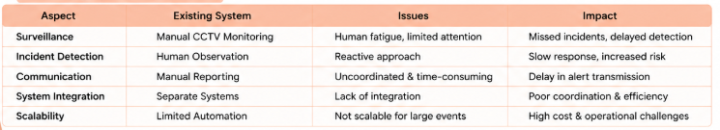
Existing System
Current Event Monitoring Approaches
Manual CCTV surveillance by security personnel.
Conventional surveillance systems record video without intelligent analysis.
Incident reporting depends on human observation and communication.
Separate systems are used for surveillance, emergency response, and volunteer coordination.
Limited automation in detecting emergencies or abnormal activities.
Reactive response after incidents have already occurred.
Limitations of Existing System
Continuous human monitoring leads to fatigue and missed incidents.
Delayed detection of fire, violence, and crowd congestion.
No automated real-time alert generation.
Poor coordination between organizers, volunteers, and emergency responders.
Difficult to locate missing persons and lost belongings.
No predictive analytics for preventing potential risks.
High operational cost due to dependence on manual surveillance.

Slide 6
LITERATURE SURVEY
Paper | Methodology | Key Contribution | Limitation
An Enhanced Framework for Real-Time Dense Crowd Abnormal Behavior Detection using YOLOv8 (2025) | YOLOv8 + Soft-NMS | Detects abnormal crowd behavior in dense public gatherings with improved accuracy (91.6%). | Focuses only on crowd anomaly detection and lacks integrated event management.
YOLOv5 + Deep SORT for Crowd Surveillance (2023) | YOLOv5 + Deep SORT + SVM | Performs crowd tracking and anomaly detection in surveillance videos. | High computational cost and reduced real-time performance in dense crowds.
GAN-Based Crowd Anomaly Detection (2022) | GAN + U-Net + Transfer Learning | Detects abnormal crowd behavior using deep learning techniques. | Sensitive to occlusions, illumination changes, and produces lower accuracy in complex scenes.
Lightweight CNN for Violence Detection (2021) | Lightweight CNN | Detects violent activities in surveillance videos with good accuracy. | Detects only violence and lacks crowd analysis, missing-person tracking, and emergency coordination.
Key Observations
Most existing research focuses on a single task such as violence detection or crowd anomaly detection.
Existing systems do not provide end-to-end event management.
Limited support for missing person identification, lost item recovery, and volunteer coordination.
Few systems integrate Computer Vision, Geo-Intelligence, and Role-Based Access into one platform.
These limitations motivated the development of Vigilance, which provides a unified AI-driven event monitoring solution.

Slide 7
Disadvantages of Existing System

Slide 8
Proposed System

Slide 9
Advantages of Proposed System

Slide 10
Disadvantages of Proposed System

Slide 11
Architecture or Flow diagram (if any)

Slide 12
Architecture Diagram Explanation

